Slide 1
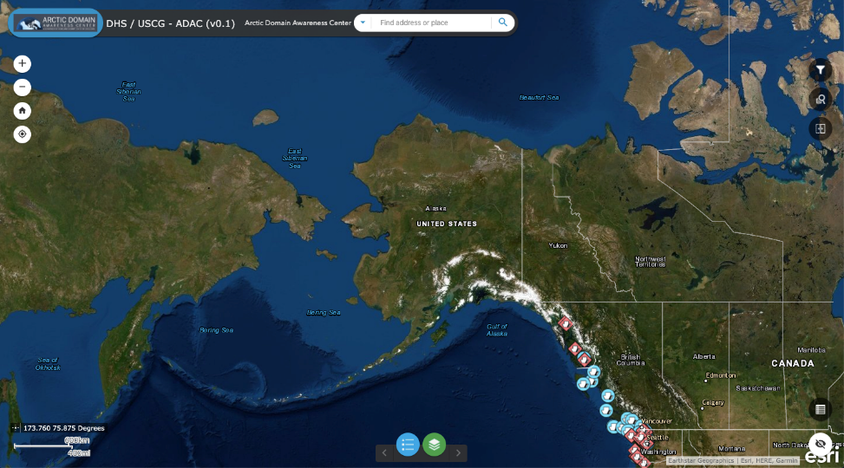
ADAC Year 6 Annual Meeting
ADAC Project Briefing
Arctic All Hazards WebGIS
Marcus A. Boyd, PhD
Director, Geospatial Research
START
University of Maryland, College Park

Slide 2
Arctic All-Hazards WebGIS: Improving User Experience and User Interface
ADAC Program Year 6 Annual Meeting 14 May 2019
Project Principal Investigator(s)
  Marcus A. Boyd, PhD
Lead Institution
  University of Maryland, College Park
Supporting Team
  Josh House, Adam Martin
Student Participation
  N/A
Project Champion
  CAPT (Ret) Hank Blaney, USCG
Project Support
  Arctic ERMA, DHS Geospatial Management Office, Homeland Security Information Network (HSIN)
Project Advocates
  District-17, USCG-HQ

Slide 3
Arctic All-Hazards WebGIS: Description and Baseline
ADAC Program Year 6 Annual Meeting 14 May 2019
Project Description: Develop an application that gives D-17 complete control over their geospatial assets in a user-friendly operating environment.
Baseline: USCG uses numerous systems, most notably Arctic ERMA, but they lack control over access, data, and visualization.

Slide 4
Arctic All-Hazards WebGIS : Relevance and Method
ADAC Program Year 6 Annual Meeting 14 May 2019
Relevance to DHS and USCG
  Numerous advancements stem from this project
  Serves as a testbed for web application development within approved DHS IT systems (HSIN and GII)
    Inherent transition, early buy-in, and native operating environment
  Advances to our understanding of displaying geospatial information
  Identified previously unknown gaps between DHS IT and USCG
  Increase overall D-17 capabilities

Slide 5
Arctic All-Hazards WebGIS : Relevance and Method
ADAC Program Year 6 Annual Meeting 14 May 2019
Research Method (Overview)
  Fundamental (basic research) questions relating to user experience (U/X) and user interface (U/I)
  Pros/Cons of different WebGIS options
  Applied development of a WebGIS

Slide 6
Arctic All-Hazards WebGIS : Relevance and Method
ADAC Program Year 6 Annual Meeting 14 May 2019
Research Method
  User Experience (U/X) and User Interface (U/I)
    Transition from map reader to map user
    Move from static to dynamic displays
    Significant research into how users experience/interact with text/image websites, less work done on WebGIS applications
      Overall lack of WebGIS user studies (Roth et al. 2017)
    Significant question: How to decrease the learning curve?
      Clean, uncluttered design

Slide 7
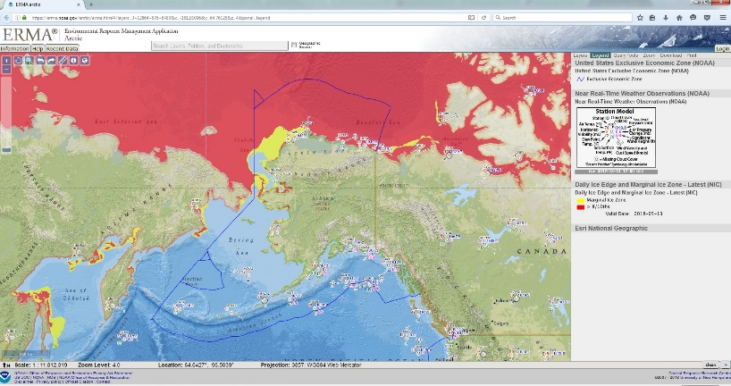
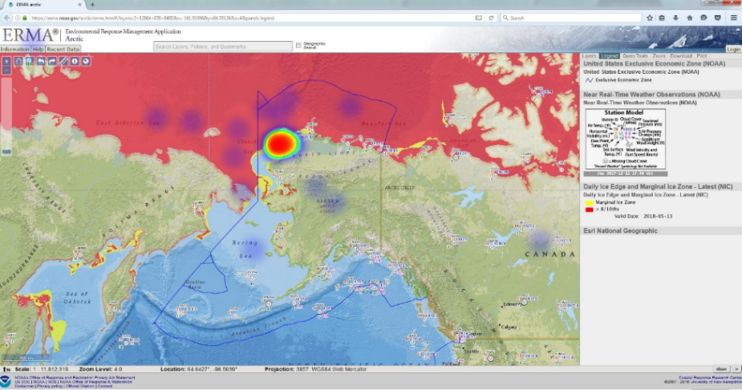
ADAC Program Year 6 Annual Meeting 14 May 2019

Slide 8
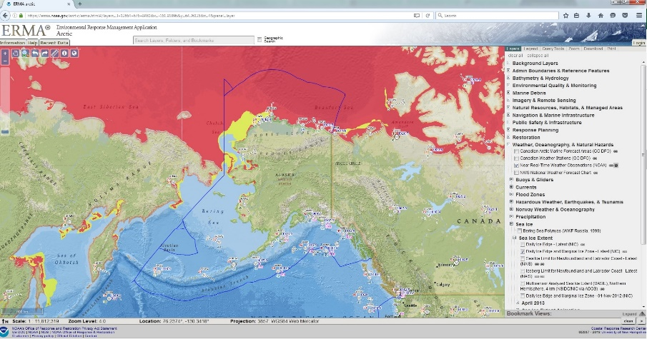
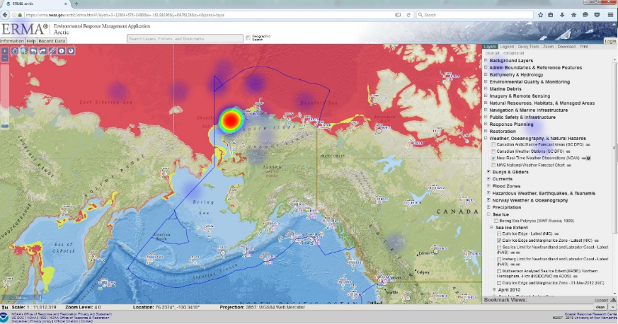
ADAC Program Year 6 Annual Meeting 22-23 April 2019

Slide 9
Arctic All-Hazards WebGIS : Relevance and Method
ADAC Program Year 6 Annual Meeting 14 May 2019
Research Method
  Pros and Cons of Different WebGIS Options
    Numerous open-source and commercial options
      Team sought an option that met USCG requirements and would integrate with DHS IT requirements to limit potential transition issues
    Open-source options present near infinite developer options
      Potential of rejection by USCG and/or DHS IT due to maintenance costs and/or security concerns
    DHS Geospatial Management Office (GMO) and CGOneView use the ESRI ArcGIS Online platform

Slide 10
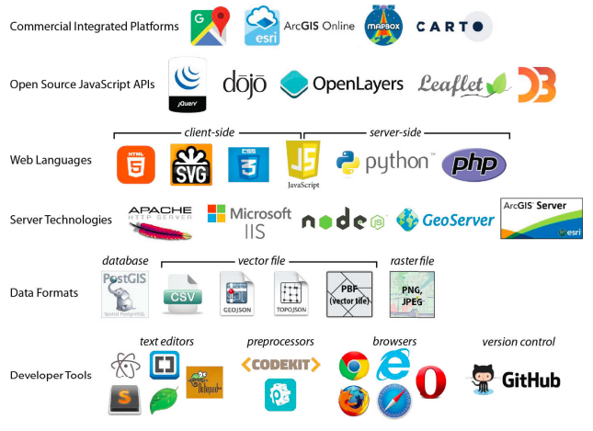
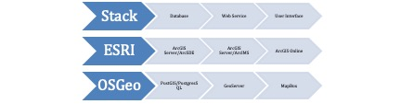
ADAC Program Year 6 Annual Meeting 14 May 2019
Typical Stack Options
Sack, 2018

Slide 11
Arctic All-Hazards WebGIS : Relevance and Method
ADAC Program Year 6 Annual Meeting 14 May 2019
Research Method
  Development of the Arctic All-Hazards WebGIS
    D-17 requirements
      Requested data specific to their needs and their federal, state, local, and tribal partners
      Requested an application that would allow for adding, storing, and sharing layers as needed
      Outlined usability issues with Arctic ERMA
        Relating to usability (data discovery and layer names)
    Data Discovery
      Captured the location of data sources
Features
AIS/Positioning Data
Chart Displays
Consolidated Weather
Environment/Sensitive Areas
Fisheries
Local Response/SAR
State/Local/Tribal

Slide 12
ADAC Program Year 6 Annual Meeting 14 May 2019
Consolidated Weather
Wind Speed/Direction
Atmospheric Pressue
Cloud Ceiling
Visibility
Sky Conditions
Precipitation
Wave Height (Swell, Direction, Wind/Sea waves)
Tide (Water Levels, Predictions)
Currents (Speed)
Air and Water Temperature
Sea Ice Extent
Ice Concentrations (Coverage/Thickness)
AIS/Positioning Data
Wide Area Dectection
Vessel Information
NRT AIS (Terrestrial, Satellite, A&B, Coastal)
View Vessel Positions (Inc. Tracklines)
AIS Filtering
Vessels Searchable (Name, IMO, etc.)
Manually Plot 'Objects of Interest'
Research Vessel Plans
Blue Force Tracking (Surface and Air)
Other Unclassified Vessel Tracking
Environment/Sensitive Areas
Endangered Species
Breeding/Nesting Grounds
Sensitive Shoreline
Fisheries
Fish Region Overlay
Marine Wildlife/Tagged Species
Chart Displays
Water Depth
Obstructions
ATON (Aids to Navigation)
Territorial/EEZ Boundaries (Inc. disputed areas)
Local Response/SAR
SAR Regions Layer within AOR
SAR Resource Information
Other Response Resources
State/Local/Tribal
POC Information for Villages
Tribal Entity Locations
Municipal Entity Locations
Traditional Maritime Subsistence Activity

Slide 13
Arctic All-Hazards WebGIS : Relevance and Method
ADAC Program Year 6 Annual Meeting 14 May 2019
Research Method
  Geospatial Information Infrastructure
    An ESRI ArcGIS Portal overseen by DHS GMO
    Available to anyone with a HSIN account
      Uses HSIN log-in and password
    Provides a backend for development of standalone webmaps, storymaps, and webGIS applications
    GMO oversees system administration
    Servers are owned by DHS IT
    Integrates with all ESRI products and applications

Slide 14
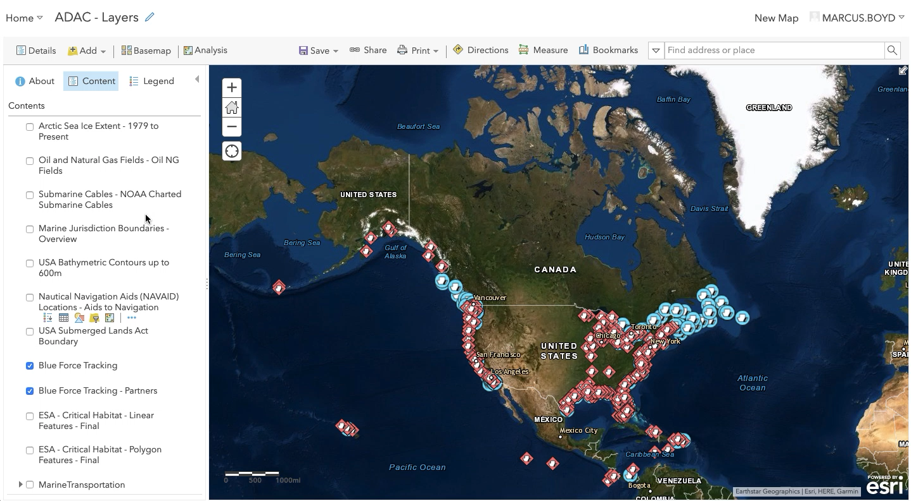
ADAC Program Year 6 Annual Meeting 14 May 2019

Slide 15
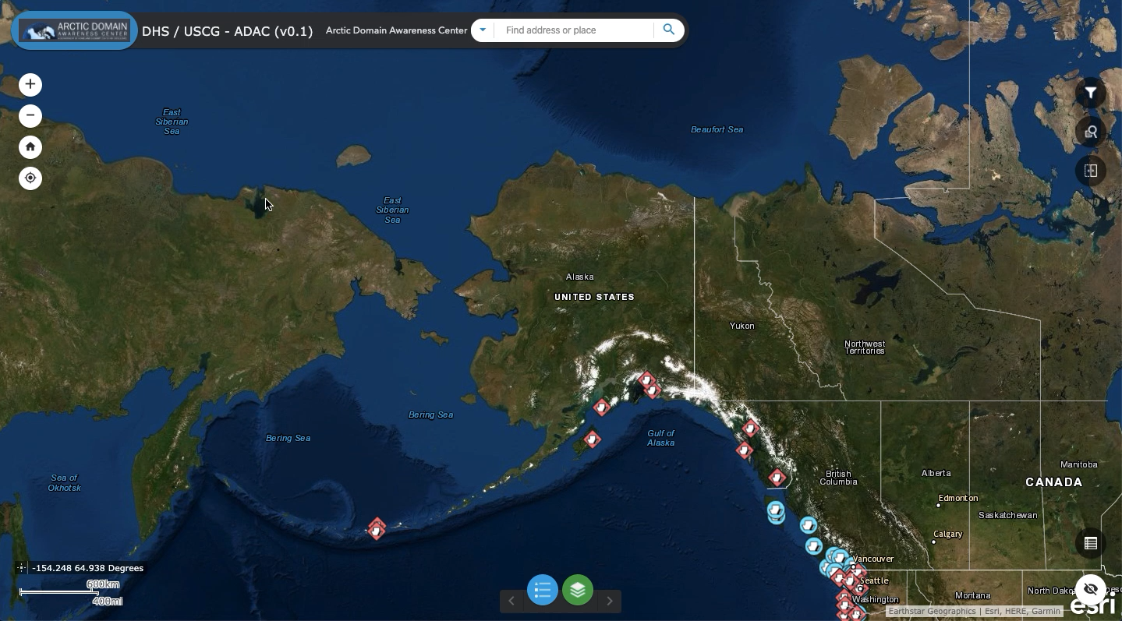
ADAC Program Year 6 Annual Meeting 14 May 2019

Slide 16
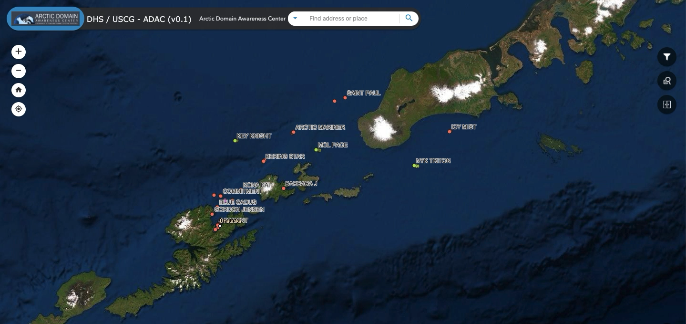
ADAC Program Year 6 Annual Meeting 14 May 2019

Slide 17
Arctic All-Hazards WebGIS: Schedule and Metrics
ADAC Program Year 6 Annual Meeting 14 May 2019
Current year research schedule and milestones:
  Go Live (TBD)
  Final Report (completed)
Current year metrics:
  Final Report is completed
  Go Live is dependent on integrating NAIS
    USCG and GMO are working on an MOU

Slide 18
Arctic All-Hazards WebGIS : Planned Research Outcomes
ADAC Program Year 6 Annual Meeting 14 May 2019
Planned outcomes of the research
  Increased understanding of how users experience webGIS applications
  Application for D-17
Please identify concluded research identification:
  Final Report – Knowledge Product
  Application – Asset for D-17/USCG

Slide 19
Arctic All-Hazards WebGIS: Key Accomplishments
ADAC Program Year 6 Annual Meeting 14 May 2019
Relay what has been the key accomplishments of the project to date:
  Furthered basic research on design and implementation of WebGIS applications
  Demonstrated a transition pathway for development of applications within existing DHS architecture
    Decreasing redundancy and cost
    Increasing interoperability

Slide 20
Arctic All-Hazards WebGIS: Transition Plans
ADAC Program Year 6 Annual Meeting 14 May 2019
Arctic All-Hazards WebGIS Application
  Exists within GII, owned by Project Champion, ready to Go Live
Prepping to publish basic research findings in academic journal
  Further our understanding of exploiting WebGIS applications and how to test their efficacy

Slide 21

Ready for questions
ADAC Program Year 6 Annual Meeting 14 May 2019
Feedback…
What are we missing?
What can we improve?
Who should we connect with to improve odds of research success?
Notes:
Thank you for the gift of your time and attention.

